Slide 1


Insights and Predictions from H-1B Dataset - Milestone 3
Bhavesh Bellara
Gaurav Hasija
Kanishka Jain
Danish Mir

Slide 2

Research Questions
Predict the time duration in days it takes for a case to be certified or denied
Predict the case decision
Predict whether the agent is present or not for the case
Predict Threshold Hourly Salary based on Employee hourly salary and Occupation

Slide 3
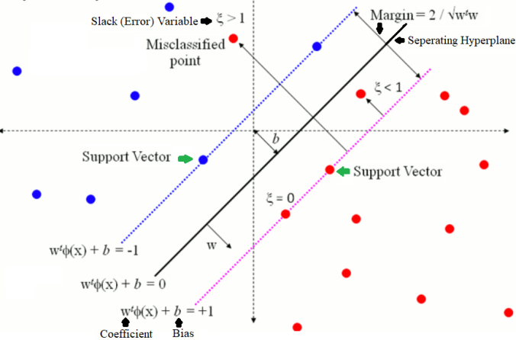
1. SVM
Questions Answered:
Predict the Case Status (Binary)
Predict if the Agent is present or not (Binary)
Predict the duration (Multiclass)
Notes:
At the end of milestone 1, we had our H1B dataset divided into 5 parts based on years. Our first goal was to combine the data under these 5 different datasets into a single dataset to make it easier in conducting further studies on it. While combining, we identified there were a lot of uncommon rows and rows with the same data but different column names. We standardized this and combined the entire data under a single dataset.
Next stage involved cleaning the data of redundancies like missing values, incorrect entries, etc. We used techniques like mean, mode to identify these redundancies and ultimately dropped these values to have a clean dataset.
The final step in getting the dataset ready for analysis was encoding the data to a standard format to make it easier to answer research questions. For example, we had to standardize the wage column as the entries were of different types like bi-weekly, monthly and annual wage.

Slide 4
1a. Predicting the Case Status
Linear Model
Non Linear Model
Agreement
FALSE | TRUE
389 | 19611
Agreement
FALSE | TRUE
357 | 19643
Accuracy: 98.05%
Accuracy: 98.21%

Slide 5
1b. Predicting if the Agent is Present
Linear Model
Non Linear Model
Agreement
FALSE | TRUE
7443 | 12557
Agreement
FALSE | TRUE
6642 | 13358
Accuracy: 62.78%
Accuracy: 66.79%

Slide 6
1c. Predicting the Duration (Range)
Linear Model
Non Linear Model
Agreement
FALSE | TRUE
4 | 19735
Agreement
FALSE | TRUE
23 | 19738
Accuracy: 98.67%
Accuracy: 98.69%

Slide 7

2. Neural Networks
Questions Answered:
Predict whether the Agent is present or not for the case.
Predict the Case Decision.
Predict the Time Duration in days for a case to be certified or denied.
Predict Threshold Hourly Salary based on Employee hourly salary and occupation.

Slide 8
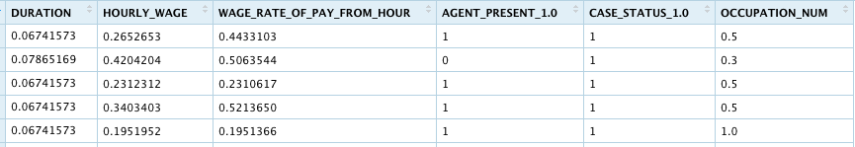
Steps Performed
For all four research questions, we have applied the model 4 to 6 times by modifying the number of hidden layers, modifying the number of neurons on each hidden layer and changing the activation function from sigmoid(logistic) to tanh and sometimes increased reps to capture better results.
We applied min-max normalization here and converted all our continuous variables to range from 0 to 1. All the factors like AGENT_PRESENT CASE_STATUS and OCCUPATION which ranged from binary values to categories were also converted to 0 and 1.

Slide 9
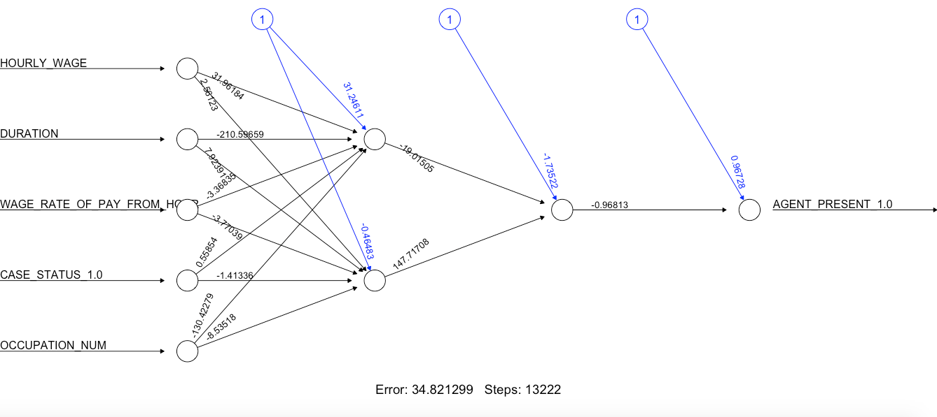
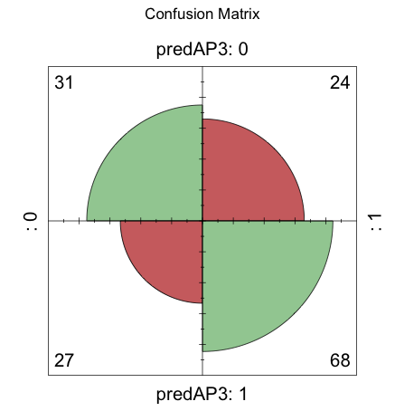
2a. Predicting whether Agent is present.
Best Model:
Two hidden layers: first with two neuron second with 1 neuron
Miss classification error: 0.33
Activation Function: ‘tanh’
Confusion Matrix: Here 0 is Agent Not Present and 1 is Agent Present

Slide 10
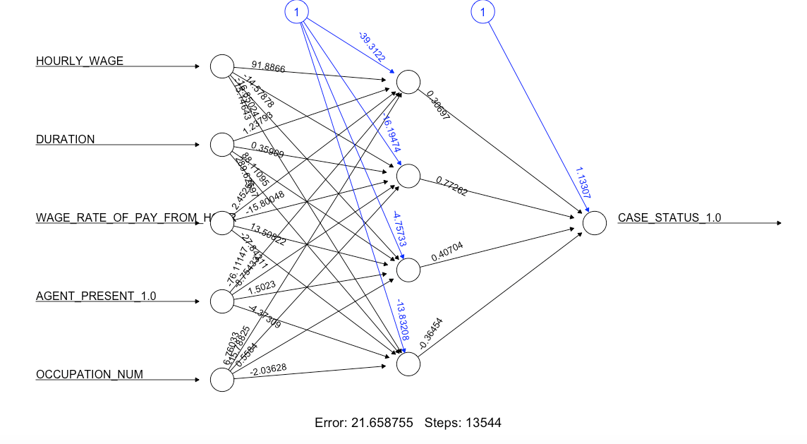
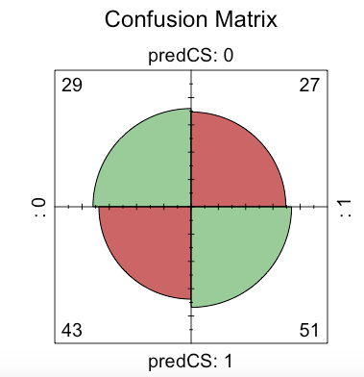
2b. Predicting the Case Decision
Best Model:
Four hidden layers:
Miss classification error: 0.4
Activation Function: ‘tanh’
Confusion Matrix: Here 0 is Case denied and 1 is case certified.

Slide 11
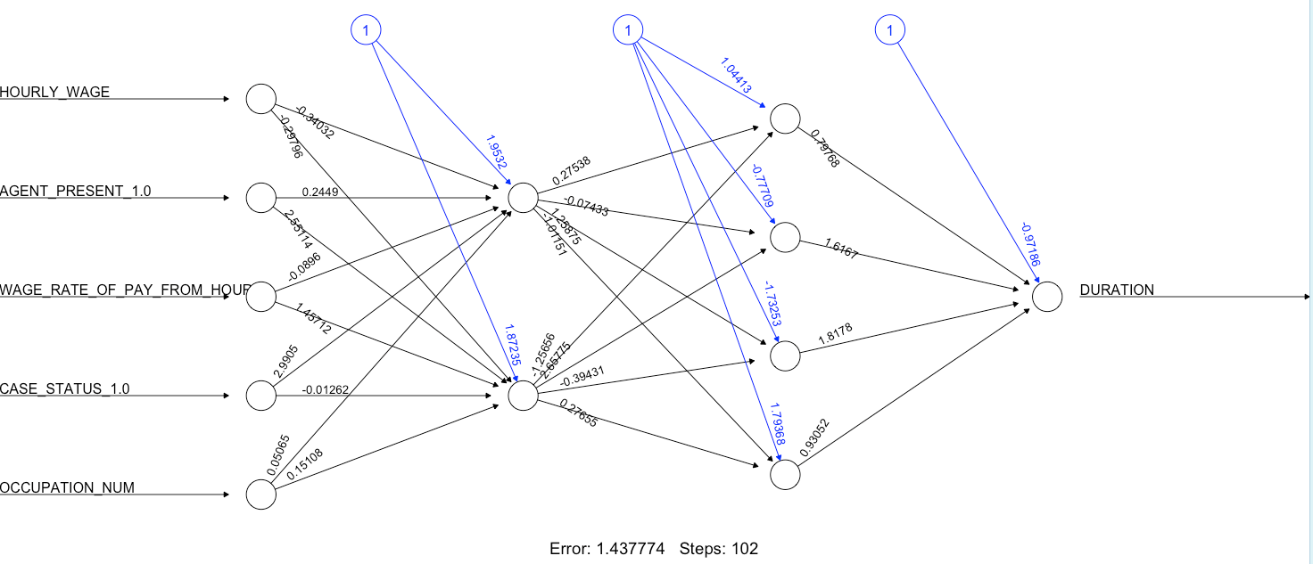
2c. Predicting the Time Duration for case to get Verified/Denied
Best Model:
Two hidden layers, first with 2 neurons and second with 4 Neurons.
Correlation coefficient: 0.1855026
Activation Function: ‘logistic’

Slide 12
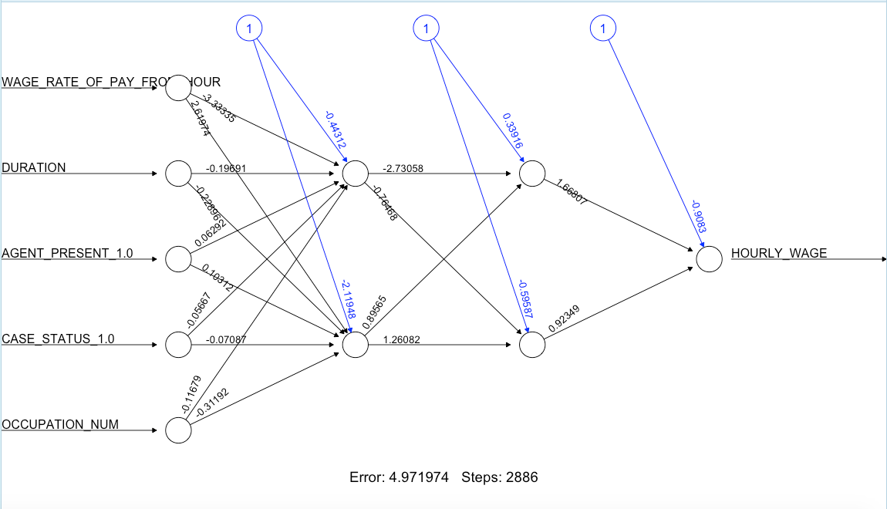
2d. Predicting the Threshold Hourly Salary
Best Model:
Two hidden layers with 2 neurons in each layer
Correlation coefficient: 0.2082862
Activation Function: ‘tanh”

Slide 13

3. Clustering
Clustering Methodologies used:
K-Means Clustering
Hierarchical CLustering
DBSM
Notes:
At the end of milestone 1, we had our H1B dataset divided into 5 parts based on years. Our first goal was to combine the data under these 5 different datasets into a single dataset to make it easier in conducting further studies on it. While combining, we identified there were a lot of uncommon rows and rows with the same data but different column names. We standardized this and combined the entire data under a single dataset.
Next stage involved cleaning the data of redundancies like missing values, incorrect entries, etc. We used techniques like mean, mode to identify these redundancies and ultimately dropped these values to have a clean dataset.
The final step in getting the dataset ready for analysis was encoding the data to a standard format to make it easier to answer research questions. For example, we had to standardize the wage column as the entries were of different types like bi-weekly, monthly and annual wage.

Slide 14
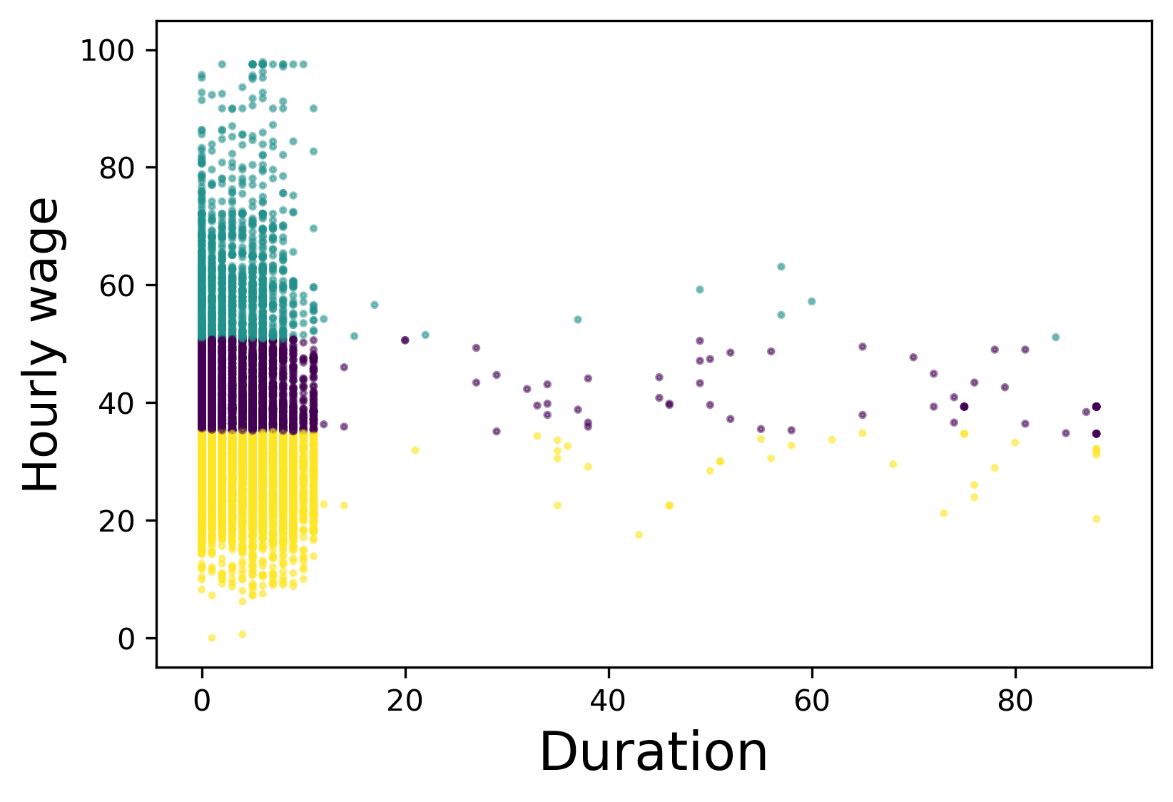
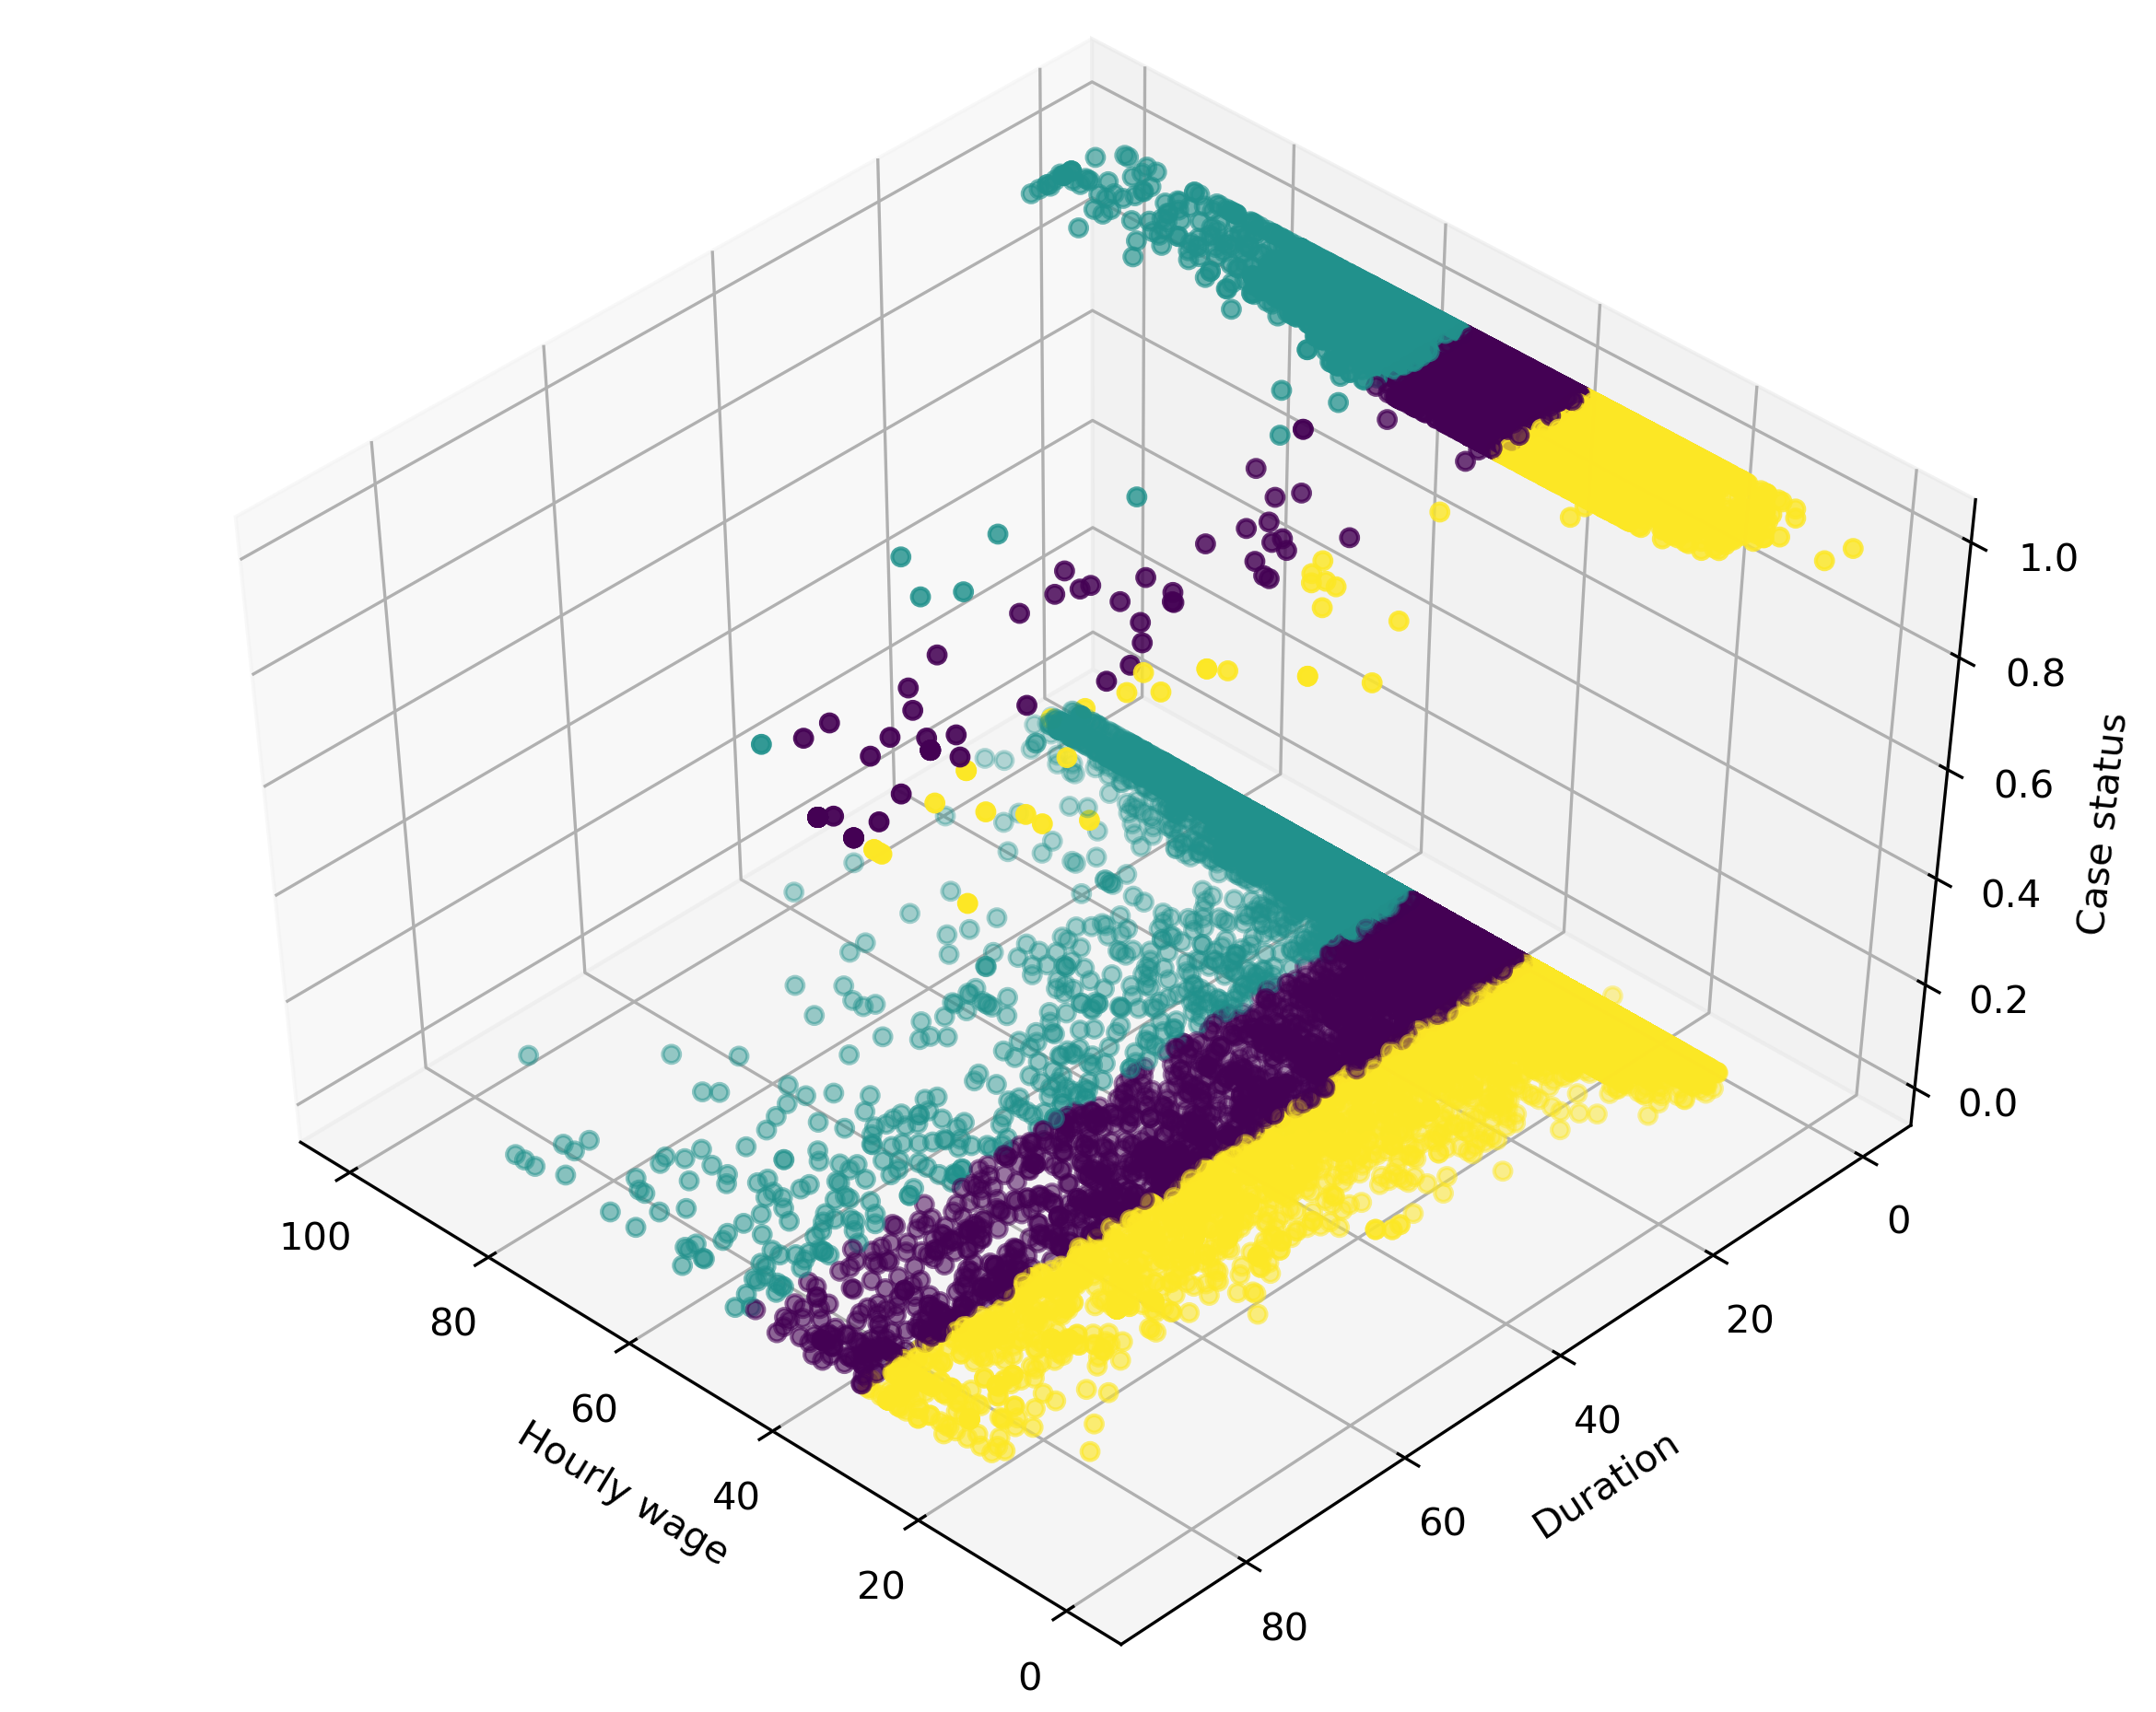
3a. K-Means Clustering
Notes:
K-Means is considered one of the simplest models amongst them. Despite its simplicity, the K-means is vastly used for clustering in many data science applications, especially useful if you need to quickly discover insights from unlabeled data.
We used K-means to look into the distribution of Case Status based on their Duration, Hourly wage, and Agent Present or not.
We used ClusterNum = 3 and n_init = 12
Further, the labels were assigned to each row in the data frame and checked the centroid values by averaging the features in each cluster.

Slide 15
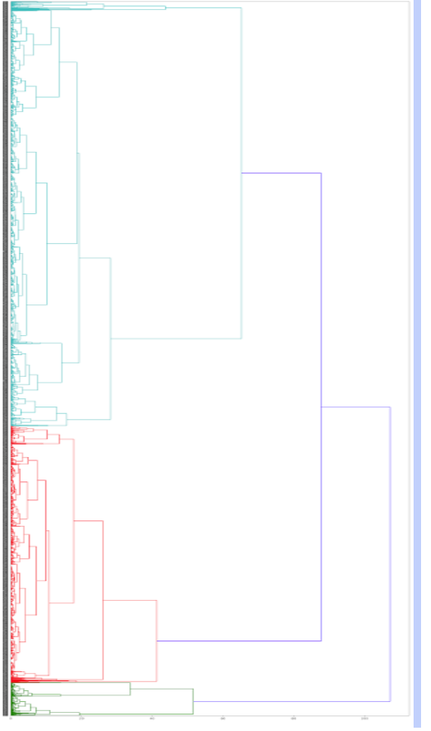
3b. Hierarchical Clustering

Slide 16
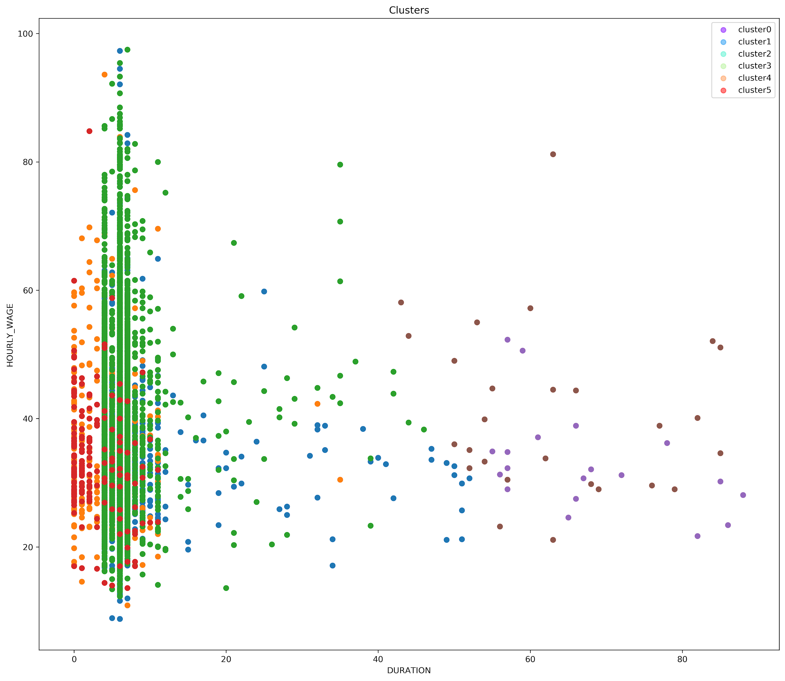
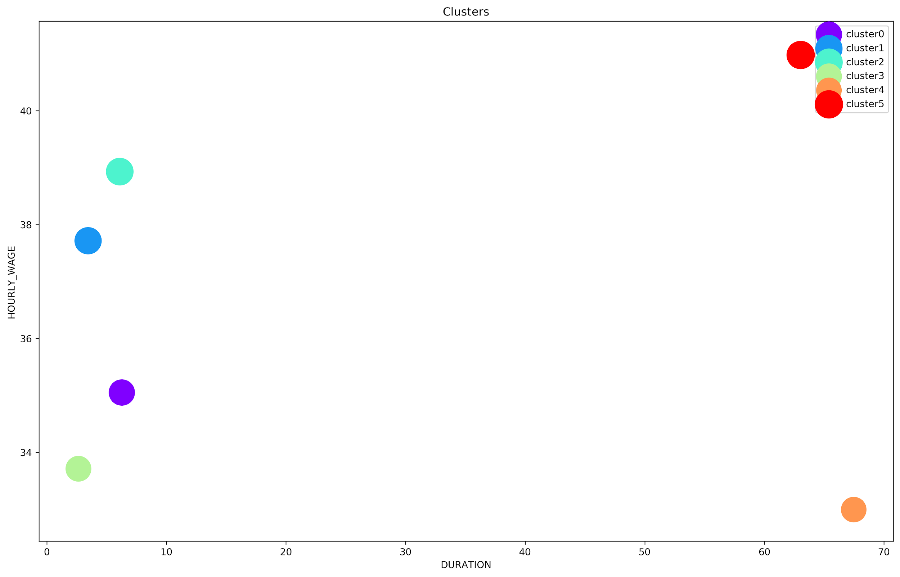
3b. Hierarchical Clustering

Slide 17
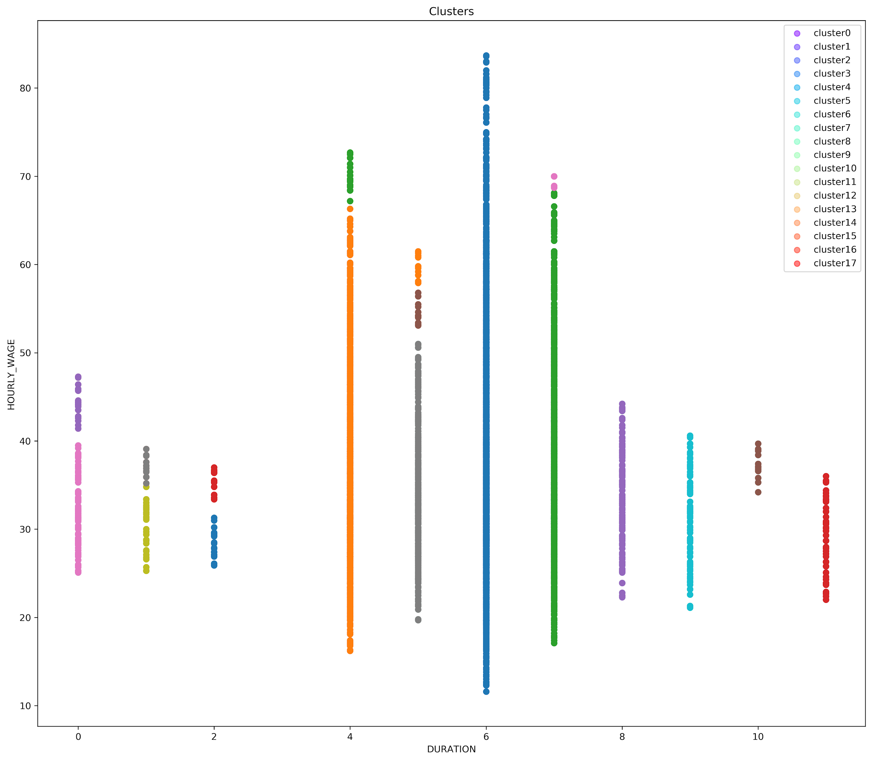
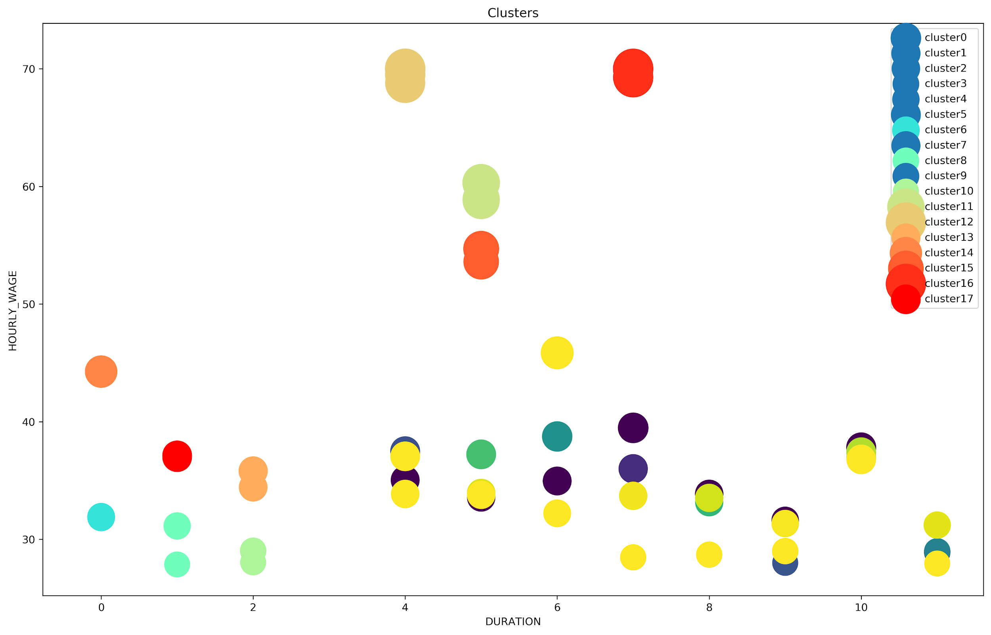
3b. DBSN

Slide 18

4. Comparative Analysis
Cross Validation Methods used (Caret package)
K-Fold
Bootstrapping
Leave Group Out Cross Validation

Slide 19
4. Comparison of Classifiers Using Caret and CV
AGENT_PRESENT
 | K-Fold | LGOCV | Boot
SVM | 61.91% | 62.2% | 62.7%
NaiveBayes | 62.82% | 61.75% | 62.05%
Decision Tree | 64.25% | 65.25% | 60.2%
Logistic Regression | 60.88% | 58% | 61.65%
CASE_STATUS
 | K-Fold | LGOCV | boot
SVM | 97.7% | 97.1% | 98%
NaiveBayes | 97.8% | 97.3 | 97.8%
Decision Tree | 97.6% | 98.1% | 96.5%
Logistic Regression | 97.6% | 96.1% | 97%

Slide 20
Thank you!

